Slide 1
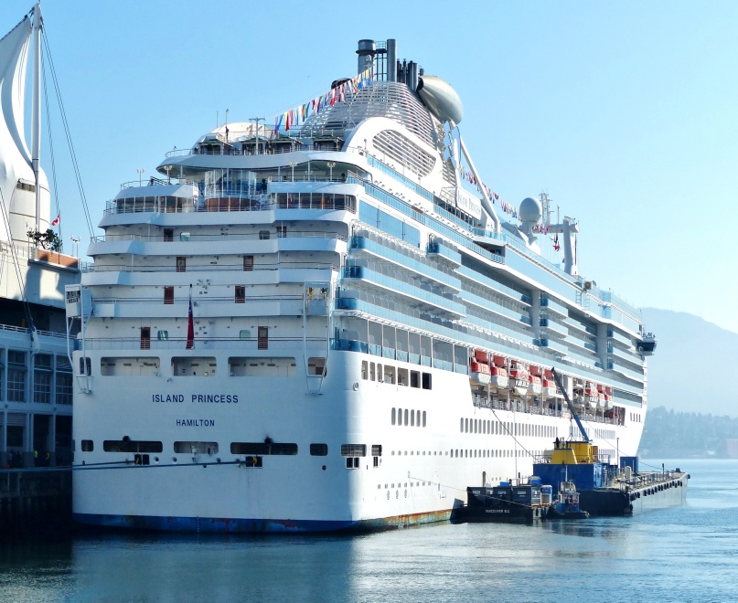
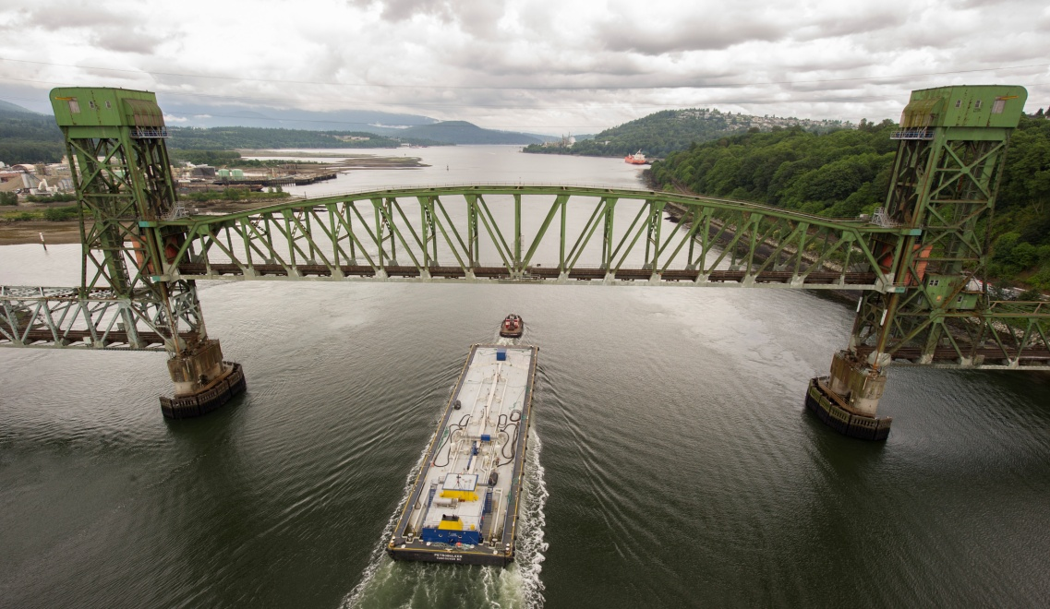
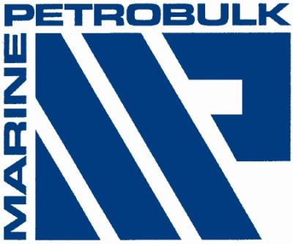
Environmental Bunker legislation and the Potential Impact on the Vancouver Market
May 2014

Slide 2
Key Organizations
IMO – International Maritime organization
MARPOL
Transport Canada – PSC officers
EC – European Union Environmental Directives
Notes:
2

Slide 3
MARPOL: International Convention for the Prevention of Pollution from Ships
IMO Convention: MARPOL 73/78 ANNEX VI
Entered into force May 19, 2005 to set limits on Sulfur dioxide and Nitrogen Oxide emissions from ship exhausts and prohibits deliberate emissions of ozone depleting substances.
2011 was a groundbreaking year: IMO adopted mandatory technical and operational energy efficiency measures to significantly reduce GHGs from ships.
Currently:
A sulphur cap of 3.50% worldwide
A max 1.00% sulphur in Emission Control Areas – ECAs
Canadian 200 mile ECA enforced as of August 2013
Notes:
3
IMO Annex VI
Regarding the International Maritime Organization (IMO) Annex VI: Prevention of Air Pollution from Ships which was adopted September 1997 (max 4.5% S worldwide and max 1.5% S in sulphur emission control areas) It will enter into force 12 months after being ratified by 15 States whose combined fleets of merchant shipping constitute at least 50% of the world fleet. Currently 6 states have ratified representing 25%.
Last month, a number of European governments committed themselves to prompt ratification. Belgium, Cyprus, Denmark, Finland, Germany, Greece, Luxemburg, the Netherlands, Panama and Spain all said that the national process for the ratification of the Protocol of 1997 to MARPOL 73/78 has reached the final stages and that they would be able to ratify Annex VI, some by the end of this year and others by the first half of 2003. The United Kingdom also indicated that the national processes were progressing. This would mean that the Annex might satisfy the entry into force conditions in mid 2003 and would enter into force before mid 2004.

Slide 4
USA/Canada environmental legislation
North American ECA
Approval made by IMO MEPC 60 in March 2010
Includes both the USA and Canada coastlines
ECA extends 200 miles from the territorial sea baseline
Became enforceable 1 August 2012 with the ECA limit at the current max 1.00% and a global limit of max 3.50% although Canada delayed enforcement to August 2013
According to the U.S. EPA, Mexico has been actively exploring the ratification of MARPOL Annex VI and establishment of a Mexican Emission Control Area (ECA)

Slide 5
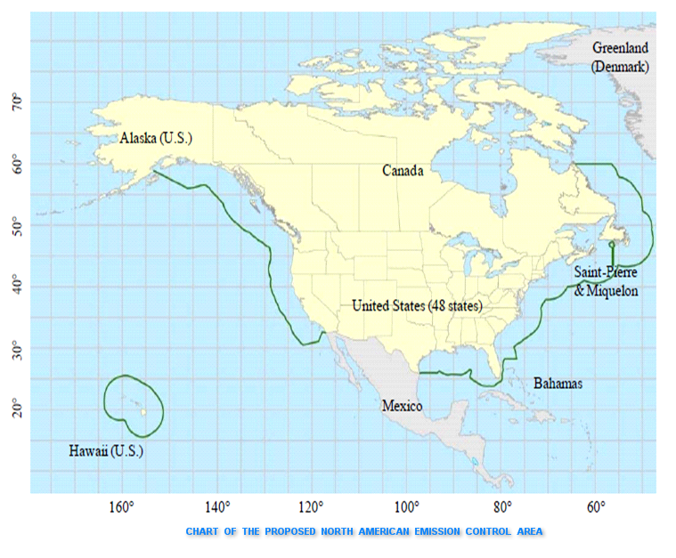
North American ECA Chart

Slide 6
IMO MARPOL 73/78 Annex VI
The amended Annex VI stipulates the following sulphur reductions:
As of 1 July 2010 – lowered sulphur limit in an ECA to 1.00% max
With the introduction of particulate matter (PM) as an emission criteria, SECA was renamed ECA (Emission Control Area)
1 January 2012 – lowered the global sulphur cap to 3.50% max
Based on samples submitted to IMO by key testing services, the worldwide sulfur average was about 2.6%. – much lower than the new limit.
1 January 2015 – lower sulphur limit in an ECA to 0.10% max
Essentially this means using max 0.10% S DMA while in an ECA. Because of concerns with obtaining this fuel outside the USA and Europe, IMO introduced a “fuel availability” provision under Regulation 18 describing the actions required to document a ship’s inability to obtain such fuel.
1 January 2020 – lower the global sulphur cap to 0.50% max
The Petroleum Industry does not believe this is achievable and therefore this change is subject to a review to be completed no later than 2018. Should the review reach a negative conclusion, the effective date would default to 1 January 2025 except in Europe where the 2020 date remains. The “fuel availability” clause would also apply globally.
Notes:
6
IMO Annex VI
Regarding the International Maritime Organization (IMO) Annex VI: Prevention of Air Pollution from Ships which was adopted September 1997 (max 4.5% S worldwide and max 1.5% S in sulphur emission control areas) It will enter into force 12 months after being ratified by 15 States whose combined fleets of merchant shipping constitute at least 50% of the world fleet. Currently 6 states have ratified representing 25%.
Last month, a number of European governments committed themselves to prompt ratification. Belgium, Cyprus, Denmark, Finland, Germany, Greece, Luxemburg, the Netherlands, Panama and Spain all said that the national process for the ratification of the Protocol of 1997 to MARPOL 73/78 has reached the final stages and that they would be able to ratify Annex VI, some by the end of this year and others by the first half of 2003. The United Kingdom also indicated that the national processes were progressing. This would mean that the Annex might satisfy the entry into force conditions in mid 2003 and would enter into force before mid 2004.

Slide 7
IMO MARPOL 73/78 Annex VI
Sulphur Summary
ECA
Prior to 1 July 2010 1.50% max
1 July 2010 1.00% max
1 January 2015 0.10% max
GLOBAL
Prior to 1 Jan. 2012 4.50% max
1 January 2012 3.50% max
1 January 2020 0.50% max
Notes:
7
IMO Annex VI
Regarding the International Maritime Organization (IMO) Annex VI: Prevention of Air Pollution from Ships which was adopted September 1997 (max 4.5% S worldwide and max 1.5% S in sulphur emission control areas) It will enter into force 12 months after being ratified by 15 States whose combined fleets of merchant shipping constitute at least 50% of the world fleet. Currently 6 states have ratified representing 25%.
Last month, a number of European governments committed themselves to prompt ratification. Belgium, Cyprus, Denmark, Finland, Germany, Greece, Luxemburg, the Netherlands, Panama and Spain all said that the national process for the ratification of the Protocol of 1997 to MARPOL 73/78 has reached the final stages and that they would be able to ratify Annex VI, some by the end of this year and others by the first half of 2003. The United Kingdom also indicated that the national processes were progressing. This would mean that the Annex might satisfy the entry into force conditions in mid 2003 and would enter into force before mid 2004.

Slide 8
North American ECA enforcement
Canada
Transport Canada Port State Control Officers (PSCO) will check relevant documentation the ship should be carrying:
the ship's bunker delivery receipt "to verify sulphur content of fuel oil supplied", and also the Material Safety Data Sheet (MSDS) for fuel oil.
the ship's record of fuel oil changeover procedures prior entering into ECA, and the record of shipboard incinerator usage.
in case a vessel cannot comply with ECA requirements due to non-availability of low sulphur fuel oil during voyage, owners must show proof that an attempt has been made to obtain low-sulphur fuel oil
PSC will consider on a case-by-case basis if a penalty will be imposed for non-compliance. This leaves some room for interpretation in cases where ships are unable to source maximum 1.00% sulfur.
Failure to provide documentation could lead to fines anywhere from $1,000 to $25,000.

Slide 9
California
California Air Resources Board (ARB) legislation revised
CARB legislation requiring all ocean going vessels enroute a California port, & within 24 miles of the coastline, to use MGO max 1.5% or MDO max 0.5% S , has been revised.
On August 1, 2012, using either ISO 8217:2005 or 2010, the MGO limit is reduced to max 1.0% while the MDO limit remains at 0.5%
Legislation that requires both MGO and MDO to be max 0.1% in the main engine, auxiliary engines and auxiliary boilers has been deferred to January 1, 2014 to roughly correspond with USA ECA shift to 0.1% in 2015 .

Slide 10
Present & Possible Future Scenario
Global Cap
2013 3.50%
2020 0.50%
Baltic Sea & North Sea ECA
2013 1.00%
2015 0.10%
2015 W. Coast Norway
US & Canada
ECA & Puerto Rico/ U.S. Virgin Islands by 2014 1.00%
2015 0.10%
California State & Port LSFO legislation to be further reduced in 2014
Except for France, Mediterranean countries not interested in an ECA
Japan study group reviewing the possibility of a national coastline ECA.
Hong Kong plans to apply to IMO to designate its port and the surrounding Pearl River Delta as an ECA, to apply a “Ringleman” smoke test in port, to limit MGO sold in the port to max 0.05% sulphur by 2014 and in 2015 mandate max 0.50% sulphur while “at berth”
No discussions underway for South American ECA
Notes:
10

Slide 11
What does this mean for bunkering in Vancouver?
Availability and supply of LS Marine Gasoil
Different ports: will they have LS Gasoil available?
Increased delivery times due to multi-product requirements.
As regulation changes, cost increases by 20-25%

Slide 12
The Future
2020 Regulations
LNG Vessels

