Slide 1
Ship Arrest & Maritime Liens for Necessaries
Presented By W. Gary Wharton
Partner, Bernard LLP Vancouver

Slide 2
Ship Arrest
In Rem jurisdiction
Not available in all courts
Extraordinary legal tool
Simple to use
Fairly inexpensive (no bond)
Secures jurisdiction
Provides security

Slide 3
Section 22 - Federal courts act R.S.C., 1985, c. F-7
Navigation and shipping
22 (1) THE FEDERAL COURT HAS CONCURRENT ORIGINAL JURISDICTION, BETWEEN SUBJECT AND SUBJECT AS WELL AS OTHERWISE, IN ALL CASES IN WHICH A CLAIM FOR RELIEF IS MADE OR A REMEDY IS SOUGHT UNDER OR BY VIRTUE OF CANADIAN MARITIME LAW OR ANY OTHER LAW OF CANADA RELATING TO ANY MATTER COMING WITHIN THE CLASS OF SUBJECT OF NAVIGATION AND SHIPPING, EXCEPT TO THE EXTENT THAT JURISDICTION HAS BEEN OTHERWISE SPECIALLY ASSIGNED.

Slide 4
Section 22 - fca
Section 22 (2) includes the following claims:
(a) with respect to title, possession or ownership of a ship …;
(b) question arising between co-owners of a ship with respect to possession, employment or earnings of a ship;
(c) in respect of a mortgage or hypothecation of, or charge on, a ship …;
(d) for damage or for loss of life or personal injury caused by a ship either in collision or otherwise;
(e) for damage sustained by, or for loss of, a ship …;
(f) arising out of an argreement elating to the carriage of goods on a ship under a through bill of lading, ….;
(g) for loss of life or personal injury occurring in connection with the operation of a ship …;
(h) for loss of or damage to goods carried in or on a ship ;
(i) arising out of any agreement relating to the carriage of goods in or on a ship or to the use or hire of a ship …;
(j) for salvage …;
(k) for towage in respect of a ship or of an aircraft while the aircraft is water-borne;
(l) for pilotage in respect of a ship or of an aircraft while the aircraft is water-borne;
(m) goods, materials or services wherever supplied to a ship for the operation or maintenance of the ship …;
(n) arising out of a contract relating to the construction, repair or equipping of a ship;
(o) by a master, officer or member of the crew of a ship for wages …;
(p) by a master, charterer or agent of a ship or shipowner in respect of disbursements …;
(q) in respect of general average contribution;
(r) arising out of or in connection with a contract of marine insurance; and
(s) for dock charges, harbour dues or canal tolls ….

Slide 5
Section 43 - fca
Jurisdiction in personam
43 (1) Subject to subsection (4), the jurisdiction conferred on the Federal Court by section 22 may in all cases be exercised in personam.
Jurisdiction in rem
(2) Subject to subsection (3), the jurisdiction conferred on the Federal Court by section 22 may be exercised in rem against the ship, aircraft or other property that is the subject of the action, or against any proceeds from its sale that have been paid into court.
Exception
(3) Despite subsection (2), the jurisdiction conferred on the Federal Court by section 22 shall not be exercised in rem with respect to a claim mentioned in paragraph 22(2)(e), (f), (g), (h), (i), (k), (m), (n), (p) or (r) unless, at the time of the commencement of the action, the ship, aircraft or other property that is the subject of the action is beneficially owned by the person who was the beneficial owner at the time when the cause of action arose.

Slide 6
Section 43 - fca
Arrest
(8) The jurisdiction conferred on the Federal Court by section 22 may be exercised in rem against any ship that, at the time the action is brought, is owned by the beneficial owner of the ship that is the subject of the action.

Slide 7
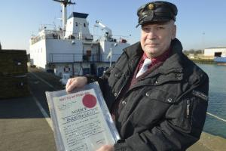
Ship Arrest
arrest of ships - Typical sequence in an arrest:
Option A:
Friday afternoon before a long weekend.
Vessel just completed loading and ready to sail.
Statement of Claim issued with a warrant of arrest. Pilots and harbor master advised.
Warrant served on the master of the vessel. Vessel arrested.
Either security is worked out or the vessel remains under arrest. Possible security is not worked out over the weekend, but possible. Vessel likely delayed.

Slide 8
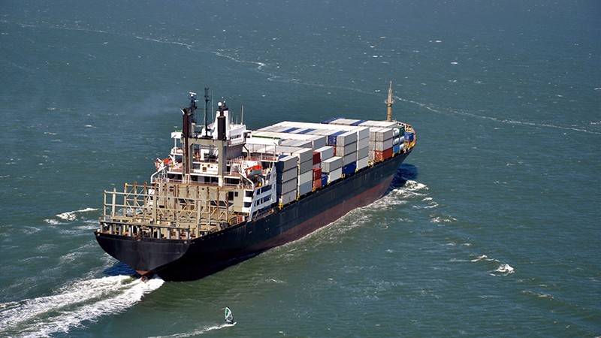
Ship Arrest
arrest of ships - Typical sequence in an arrest:
Option B:
Thursday morning before a long weekend.
Claimant’s lawyer calls and threatens to arrest if adequate security is not given. Says will take LOU from insurer.
I contact the insurer and ask for authority to issue a LOU for an agreed amount (usually about 130-150% of the claimant’s best arguable case). I get authority over night.
Friday morning I negotiate the wording of the LOU with the Claimant’s lawyer and sign and send over the LOU.
The ship goes on its way. The Claimant has security. No delay.

Slide 9
Golden Trinity
How far will the court go to assist?

Slide 10
Ship Arrest
arrest of ships - Security to obtain the release of the vessel from arrest:
Court approved security: 1) guaranty from a Canadian bank; 2) letter from a properly licensed insurer in Canada; 3) bail bond; 4) cash in a trust account or paid into court. Expensive.
Commonly accepted security, but not court approved: P&I Club Letter of Undertaking (LOU). Not so Expensive.
Bail hearing if cannot agree on the amount of security.
Amount of security: based on best arguable case, but is the lessor of the value of the claim (plus something for costs and interest) or the value of the vessel. So, if the vessel is worth less than the claim, all you get is the value of the vessel.

Slide 11
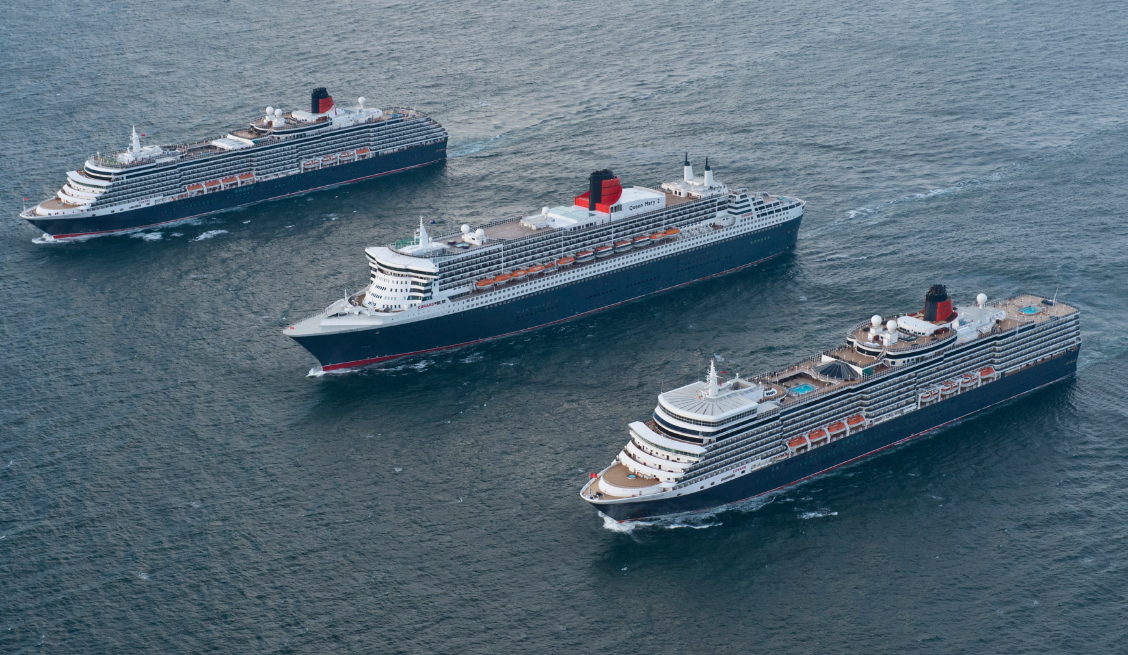
Ship Arrest
arrest of ships - Other points regarding arrest:
Ship must be in Canada for our court to be able to arrest.
A claim for wrongful arrest is very limited and really only available if the arrest was not exercised in good faith. The shipowner can then get damages for delay and related losses.
The cost of security such as a bank guarantee are costs in the lawsuit so if the claimant loses they pay.
Can arrest a sistership that at the time the action is brought, is owned by the beneficial owner of the ship that is the subject of the action (Federal Courts Act, s. 43(8)).
The cape apricot – can you arrest more than one ship?

Slide 12
Caveats: Rule 493 - FCA
Caveat warrant (i.e. Caveat Arrest)
493 (1) A person who desires to prevent the arrest of property shall serve and file a caveat warrant in Form 493A undertaking to give, within three days after being required to do so, bail in respect of any action that has been, or may be, brought against the property.
Caveat release
(2) A person who desires to prevent the release of any property under arrest shall serve and file a caveat release in Form 493B.

Slide 13
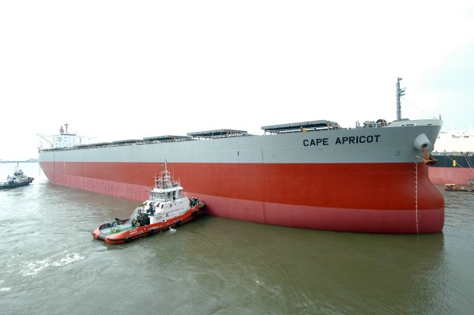
Cape Apricot
Westshore Terminals Ltd. v. Leo Ocean, S.A. 2014 FC 136
Westshore Terminals Limited Partnership v. Leo Ocean, S.A. 2014 FCA 231

Slide 14
Findings of cape apricot
“any” means “anyone ship”
Option but risk
Security only to value of vessel

Slide 15
Maritime liens
Maritime Liens (as distinct from a simple right to arrest)
Usually enforced by arrest but are different from the simple right of arrest:
Privileged claim – has priority over simple arrest claims;
Arises automatically – no formality required.
Attaches immediately;
Travels with the ship - Survive transfer of ownership or change of registration; and
Direct contract or tort Liability of owner not usually necessary.

Slide 16
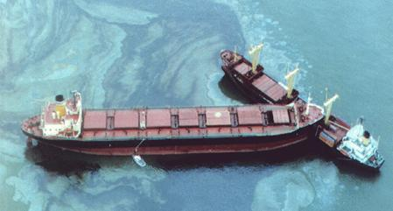
Maritime liens
Maritime Liens – traditional Maritime liens include:
Court costs, custodia legis and Attorney’s fees;
Seaman’s and master’s wages;
Salvage liens;
Collision damage and ship tort liens;
Master’s disbursements;
S 139 maritime liens.
Quasi maritime liens:
General average;
Pilotage.
Priority type claims:
Preferred ships mortgages;
Dock and harbour dues, etc.

Slide 17
Usual order of priorities
Court costs and Marshall’s expenses (Custodia Legis);
Possessory liens predating other liens;
Statutory liens (including the statutory lien for seaman’s wages under the Canada Shipping Act);
Maritime liens (including foreign maritime liens);
Possessory liens arising after other maritime liens;
Claims by mortgage holders; and
Statutory rights in rem (including ship repairers and necessaries suppliers).

Slide 18
Marlex Petroleum Inc. v. Har Rai (The)

Slide 19
Maritime Liens - s. 139 of the Marine liability act
139 (1) In this section, foreign vessel has the same meaning as in section 2 of the Canada Shipping Act, 2001.
Maritime lien
(2) A person, carrying on business in Canada, has a maritime lien against a foreign vessel for claims that arise
(a) in respect of goods, materials or services wherever supplied to the foreign vessel for its operation or maintenance, including, without restricting the generality of the foregoing, stevedoring and lighterage; or
(b) out of a contract relating to the repair or equipping of the foreign vessel.
Services requested by owner
(2.1) Subject to section 251 of the Canada Shipping Act, 2001, for the purposes of paragraph (2)(a), with respect to stevedoring or lighterage, the services must have been provided at the request of the owner of the foreign vessel or a person acting on the owner’s behalf.
Exception
(3) A maritime lien against a foreign vessel may be enforced by an action in rem against a foreign vessel unless
(a) the vessel is a warship, coast guard ship or police vessel; or
(b) at the time the claim arises or the action is commenced, the vessel is being used exclusively for non-commercial governmental purposes.
Federal Courts Act
(4) Subsection 43(3) of the Federal Courts Act does not apply to a claim secured by a maritime lien under this section.

Slide 20
Maritime Liens for Necessaries
Maritime Liens - s. 139 of the Marine liability act
Amendments to the Marine Liability Act created a new maritime lien for “necessary suppliers” under s. 139.
Canadian necessary suppliers now have rights similar to their U.S. counterparts.
Must be Canadian supplier.
Must be to Foreign ship.
Stevedoring still requires direct contract with owner.

Slide 21
Equitable reordering

Slide 22
THANK YOU
ANY QUESTIONS?

