Slide 1
Hanjin Bankruptcy: Global/Local Impact
John Bromley - May 10, 2017

Slide 2
South Korea’s largest container line
Tenth largest container carrier
Owner and charter of container ships, bulk carriers, LNG carriers and tankers
Owner of fourteen dock yards – four in Korea, two in the USA, two in Japan and the remainder in Spain, Taiwan, Vietnam and Belgium

Slide 3
Difference from other insolvencies:
- large container line
- numerous shippers/consignees for each container vessel
- numerous contracts of carriage which were with Hanjin and not with the owner of the ships (if not Hanjin)

Slide 4
August 31 2016 - Hanjin files for Court protection in Seoul in order to reorganize after banks withdraw support. The order provides a prohibition on arresting or seizing a Hanjin asset.
Sept 1, 2016 – HANJIN VIENNA is due to leave Deltaport and is arrested by Saam Smit.
Sept 1, 2016 – HANJIN SCARLET arrives at Prince Rupert but is not allowed to come to berth until arrangements are made for payment of harbour dues, berthage, wharfage and terminal charges.
Sept 6, 2016 - Cosco and YangMing agree to pay the cost of berthing the HANJIN SCARLET and the discharge of their containers (about 400)
Sept 14, 2016 – HANJIN SCARLET arrested by DP World Prince Rupert after the vessel returns to anchorage

Slide 6
Caveats and arrest warrants are filed against the HANJIN SCARLET BY
CN
Prince Rupert Port Authority
Singamas Petroleum Trading Pte Ltd
KPI Bridge Oil Singapore Pte Ltd
ING Bank N.V. Singapore Branch
Pacific Pilotage Authority
Eco Intermodal

Slide 7
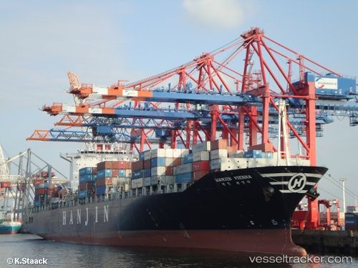
On September 6, 2016, the US Bankruptcy Court grants an order recognizing and enforcing the Korean Court order in the US and further preventing the arrest of any vessel operated by Hanjin.
On September 9, 2016 the US
Bankruptcy Court order is amended
to allow a cargo owner at its own
expense to obtain containers
not yet discharged or held at
terminals so long as the ocean
freight had been paid.
Similar orders are made by the
Courts of Germany, Netherlands, England, Spain and Italy.
As a result, the assets of Hanjin cannot be seized in those jurisdictions. However, Hanjin needs to provide funds if it wants to load/discharge cargo.

Slide 8
On October 4, 2016 Hanjin obtained an order of the BC Supreme Court preventing an action from being taken against Hanjin or any action affecting Hanjin’s business. However, the order left the Federal Court actions active and it was left to Hanjin to apply for a stay of those actions.
It never did.

Slide 9
Situation early October
No new actions against Hanjin assets i.e. ships or containers possible without leave of the B.C. Supreme Court.
2583 containers on the HANJIN VIENNA destined for other ports.
Over 800 containers on the HANJIN SCARLET destined for North America
Customers scrambling to obtain their goods

Slide 10
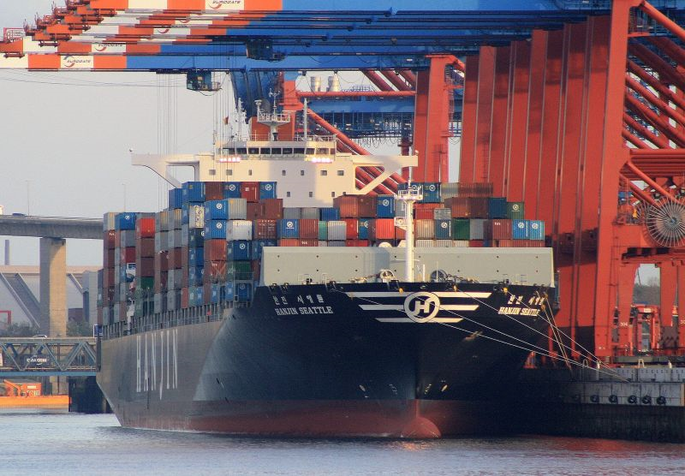
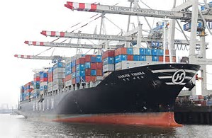
Hanjin obtains court orders to have the HANJIN VIENNA and the HANJIN SCARLET moved to berth in Vancouver and the containers discharged.
The containers on the HANJIN VIENNA are to be transshipped to the HANJIN SEATTLE

Slide 11
Both the HANJIN VIENNA and the HANJIN SCARLET are returned to their owners.
No hire had been paid to the owners of the HANJIN VIENNA since April 2016.
January 18, 2017, owners apply for an order for sale of the ship and on February 16, 2006 the HANJIN VIENNA is sold for US $6,676,000.00
All of the in rem claimants are now seeking recovery of the amounts owed to them from the sale proceeds and the owner is challenging all of the in rem claims.

Slide 12
ING Bank commences an action against the HANJIN SCARLET on December 8, 2016 claiming US$79,861,341.72
No mortgage payments had been made on the HANJIN SCARLET since July 2016
The Bank has taken no action as of yet to sell the ship.

Slide 13
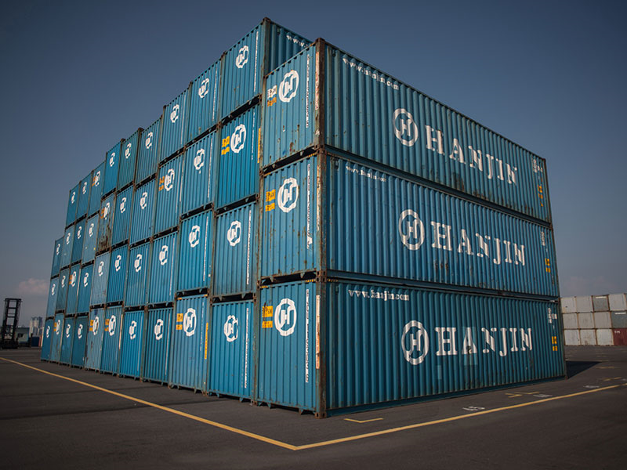
Hanjin owned and leased containers.
Those containers were all over the world.
DP World moved in February in the Federal Court to sell 243 Hanjin leased containers in its possession for demurrage and other charges owing. Demurrage accrued at the rate of $108.83 per day

Slide 14
Shippers/consignees willing to pay charges owing on their containers to get them released but sometimes found themselves facing lien charges from Hanjin for previous shipments
Hanjin carriage terms stated
11. LIEN
(a) The Carrier shall have a lien on the Goods, for all freight, dead freight, demurrage and the costs and expenses of recovering the same and any other sums whatsoever payable by the Merchant under this Bill of Lading or any other Bill of Lading between Carrier and Merchant and may enforce this lien, by all available means, including public or private sale….

Slide 15
It Ain’t Over
On March 8, 2017, DP World arrested the KMARIN ATLANTICA which is the current name of the HANJIN MAR. Caveat Releases are filed by
Prince Rupert Port Authority
CN
GCT
Ship is delayed by almost a week before security is arranged and the ship released.

Slide 16
Thank You

